Slide 1
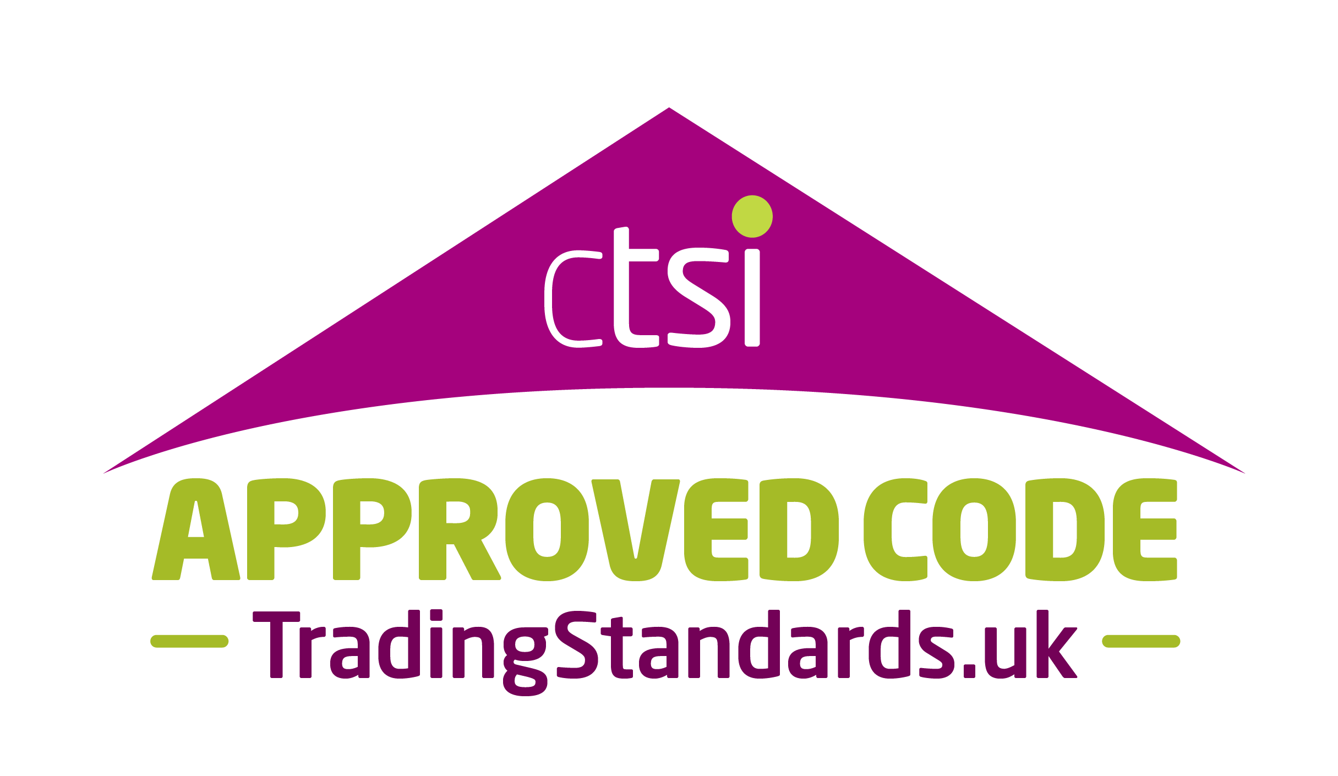

Consumers don’t always know who to trust
Every year, UK consumers lose £70bn
to poor service,
rogue traders, and unresolved disputes.
Honest businesses are being undermined by those that cut corners.
Markets work best when consumers feel confident — but trust isn’t always clear.
That’s where the Approved Code Scheme (ACS) comes in.

Slide 2


What is the Approved Code Scheme (ACS)?
ACS is a UK-wide scheme where businesses:
• Commit to higher standards of customer service
• Are independently audited by Trading Standards
• Provide free, impartial dispute resolution
How does this relate to your membership with
[INSERT YOUR ORGANISATION’S NAME]?
• [Organisation name / Code] is an approved Code Sponsor of the Approved Code Scheme, which means we are committed to promoting the codes of practice that meet ACS approval
• The Approved Code Scheme is the UK’s only sector-wide code framework audited by Chartered Trading Standards Practitioners.
• This means, we too are independently audited and therefore operate at the highest of industry standards
Established in 2001
40,000+ approved businesses
Independently governed by the Consumer Codes Approval Board
Raising standards, protecting consumers.

Slide 3
Why it matters for your business
ACS helps you:
• Stand out as a trusted, credible business
• Build stronger customer confidence at the point of purchase
• Demonstrate commitment to doing the right thing
• Differentiate from competitors who cut corners
A recognised mark that signals accountability and quality.
Part of a network of 40,000+ approved businesses that extend
beyond our sector
Place the ACS and [insert Code Sponsor name] combined logo on all your marketing material so customers know your business is following a nationwide-recognised code!

Slide 4


The mark of businesses
you can trust.
What it means for your customers
The Approved Code Scheme makes it easy for customers to choose businesses they can trust. The ACS mark demonstrates to consumers that your business:
• Meets strict codes of practice, delivering services customers can rely on – more than just good reviews
• Is trustworthy and accountable
• Provides customers with access to free, impartial dispute resolution if things go wrong
www.approvedcode.tradingstandards.uk
www.linkedin.com/company/approved-code-scheme
www.facebook.com/ApprovedCodeScheme
https://x.com/approvedcode

